Slide 1
LOCATION BASED MARKETING USING MOBILE APPLICATION
BY:-
SEEMA UBHARE
AKSHAYA PATIL
VARAD TUPE
PROJECT GUIDE : PROF. S.M.PATIL

Slide 2
INTRODUCTION
The proposed system is a mobile application that has potential to become a new marketing model that would help in boosting the reach of small business owners towards its customers in their locality as well as other distant customers.
Attraction through OFFERS, DISCOUNTS, SALES.
Easy searching of OFFERS, BUSINESS using user’s location.
Developing this application would eventually create a new business firm.

Slide 3
EXISTING SYSTEM
GROUPON
Groupon is international company offering deals on travel, hotels, restaurant, spas, etc. in more than 500 markets around the world.
It allows you to buy and redeem groupon coupons from website or mobile app.
Front End: AJAX/JavaScript/HTML/CSS along with client-side JavaScript frameworks like jQuery, Backbone.js, Objective C, Java etc.
Back End: NoSQL MongoDB for database along with coding languages such as Ruby/JRuby, Rails, Java, MySQL, Redis, Resque and other web technologies.

Slide 4
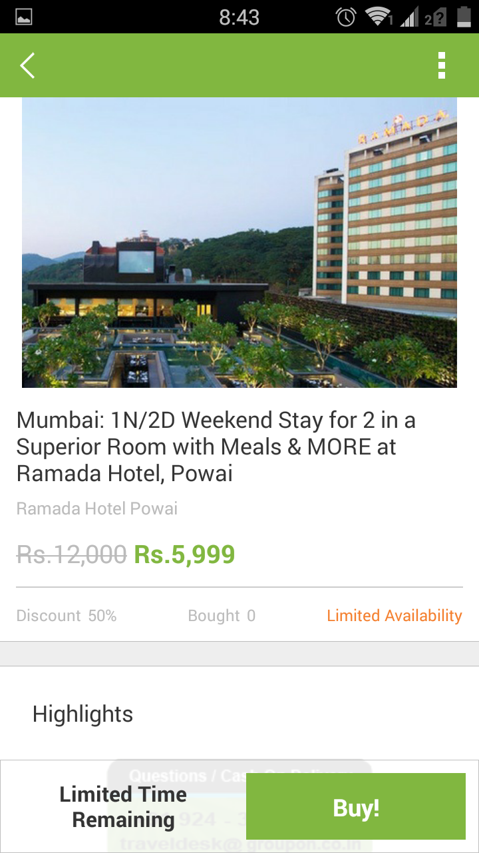
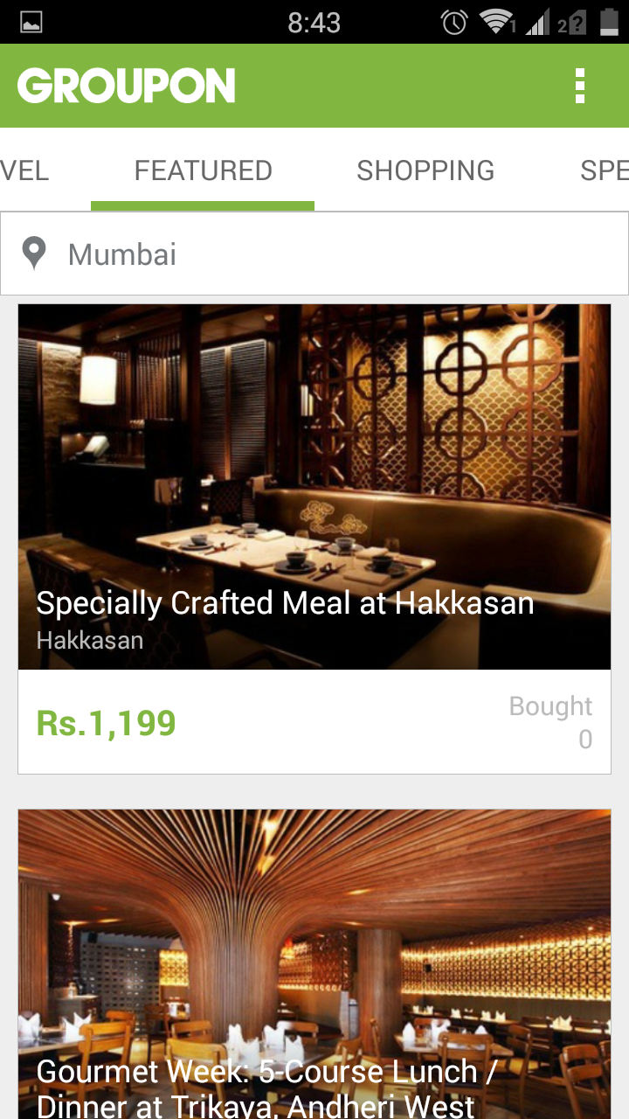
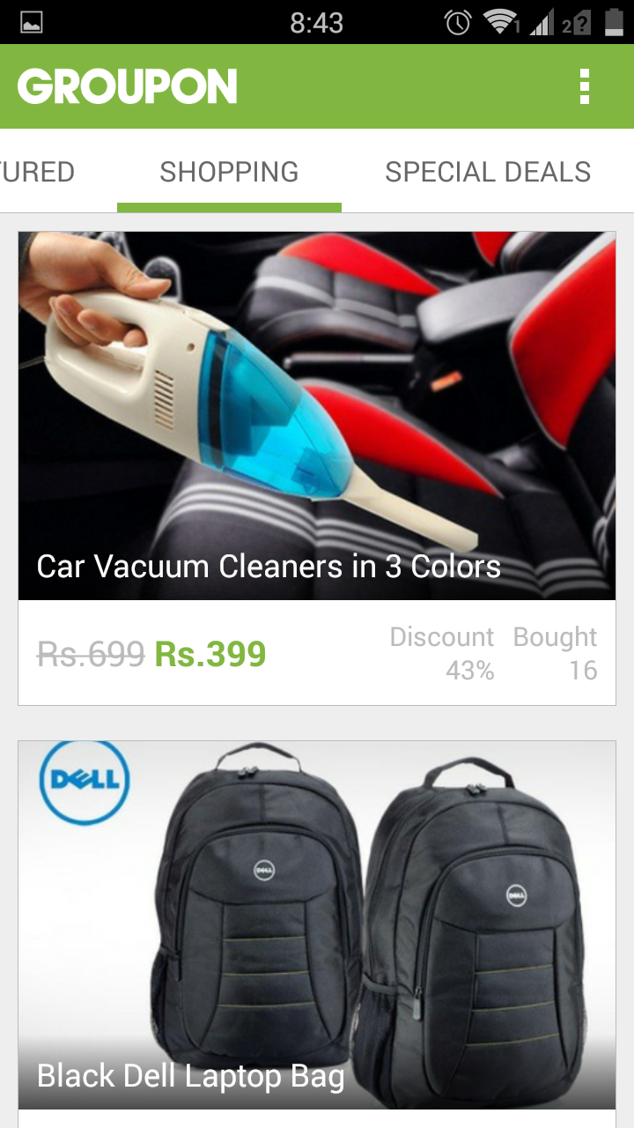

Slide 5
EXISTING SYSTEM (Contd.)
SAVEZIPPY
Developed in Banglore by Pipal Tech Ventures.
Provides discount coupons of various E-commerce websites.
Back End: NoSQL/ MongoDB for database along with coding languages such as Python/Java/Ruby/PHP for backend.
Front End: AJAX/JavaScript/HTML/CSS along with client-side JavaScript frameworks like jQuery, Backbone.js, etc.

Slide 6
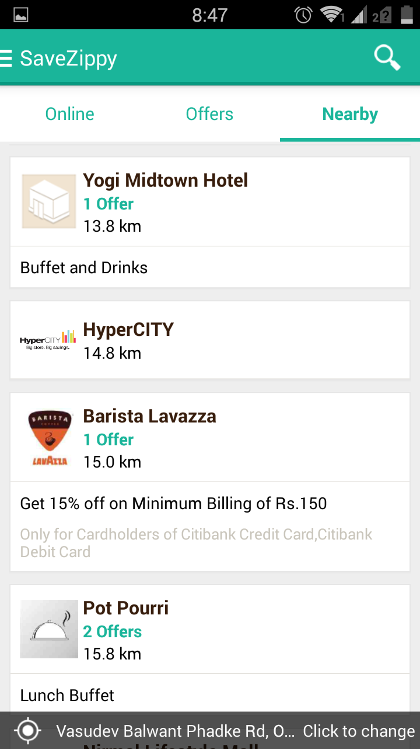
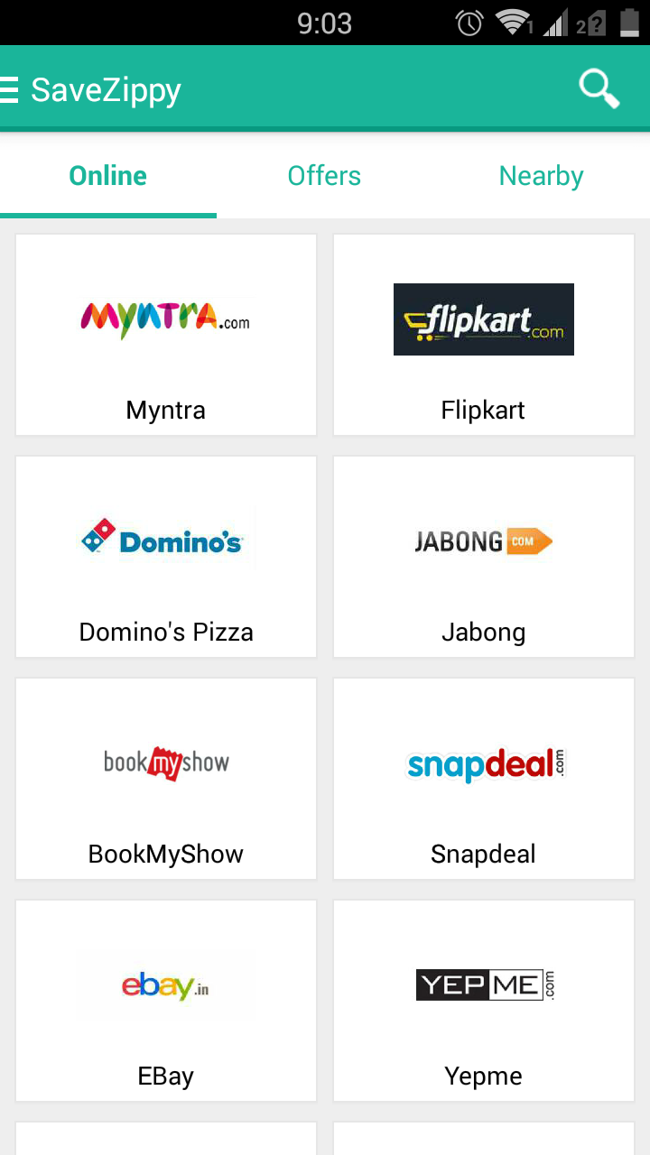
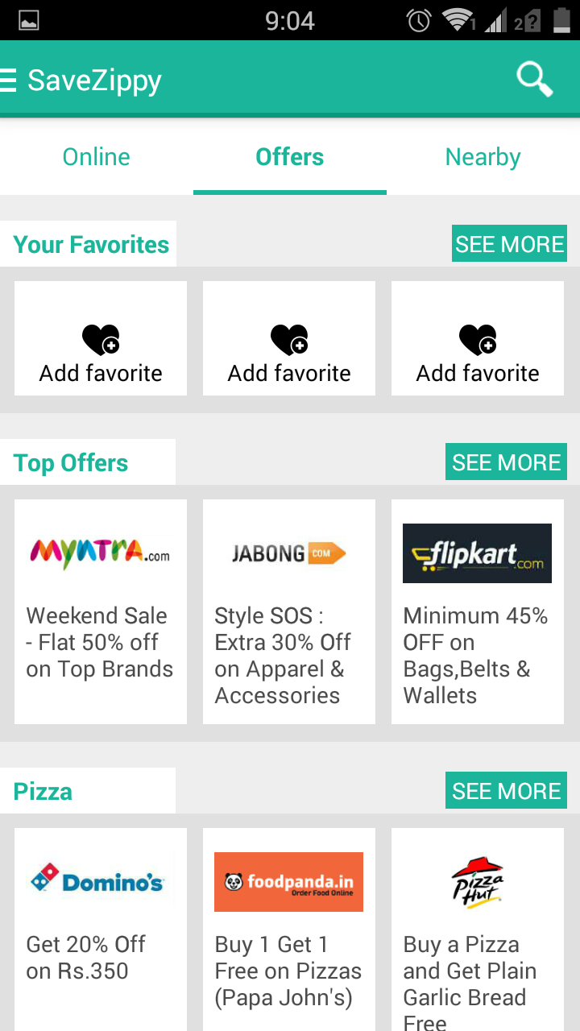

Slide 7
EXISTING SYSTEM (Contd.)
Other Similar Services
Hike, Freecharge, etc
These all services provide discount coupons which could be redeem at shops or websites before checking out.
HIKE: Provide offers in the form of REWARDS on usage of application
FREECHARGE: Provides coupons equivalent to the amount of recharge or bill you pay.

Slide 8
Parameters | Traditional Marketing | Groupon | SaveZippy | Other Services (Hike/Freecharge)
Marketing Medium | Radio, TV, Newspapers, Hoardings, Posters, SMS, Fliers etc | Website, Mobile Application | Website, Mobile Application | Website, Mobile Application
Location Based Service (LBS) | No LBS | Not Available in India | Yes but offers are not accurate to user’s location | No LBS
Map View | No map view | Available in India but on individual offers | No map view | No map view
Clients | Any Business | Popular Brands and Franchises. | Popular Brands, Franchises, very few Medium Scale Businesses | Popular Brands, Mostly Franchises.
Interface | Static Advertisement | User Friendly interface with minimal navigation | Clumsy interface. | Hidden interface for offers. Simple Navigation
Categorization | No categorization | Less specific categorization | Good Categorization | No categorization in Freecharge. Simple categorization in Hike (3)

Slide 9
PROBLEM STATEMENT
Traditional marketing strategies are inefficient.
Personalized location based advertisement cannot be provided by traditional marketing.
There are few marketing applications available but there are some drawbacks associated with them
Improper/Inefficient categorization of data.
Inaccurate display of data with respect to location of user.
Popular & big brands can afford big marketing strategies to efficiently deliver their product information and offers to their customer but for small business cannot do the same.

Slide 10
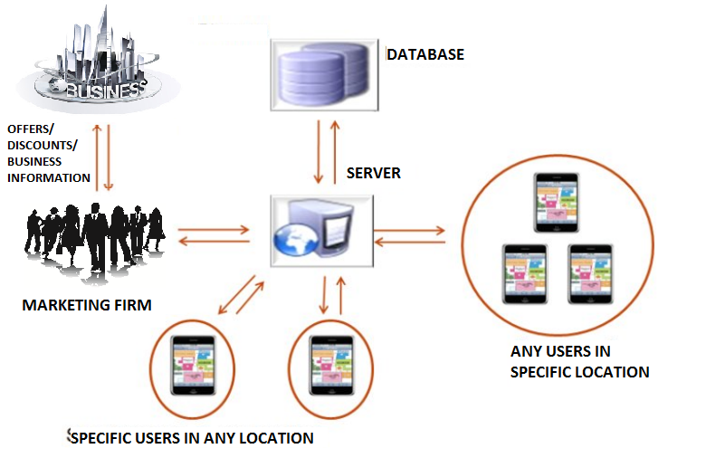
ARCHITECTURE/BLOCK DIAGRAM

Slide 11
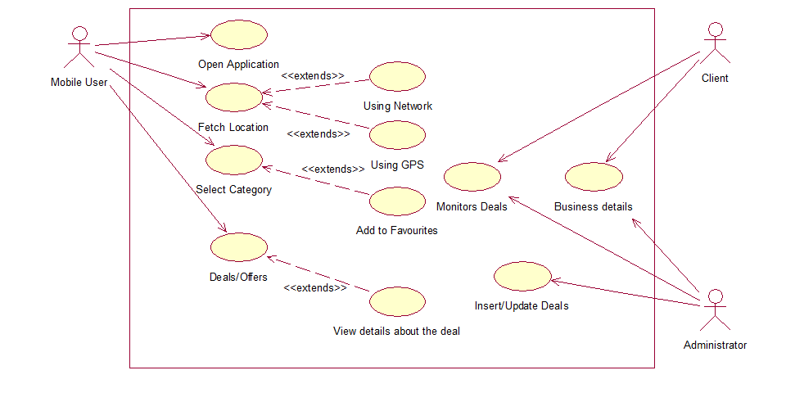
Use Case Diagram

Slide 12
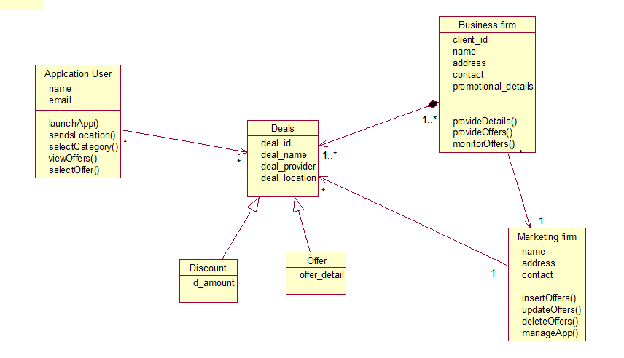
Class Diagram

Slide 13
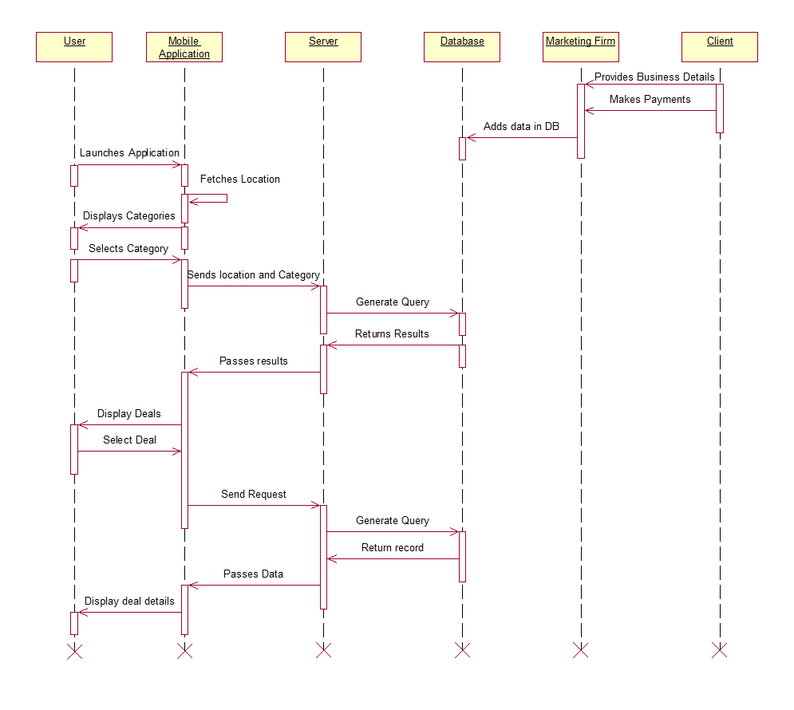
Sequence Diagram

Slide 14
Conclusion
The system overcomes the drawback of traditional marketing.
System provides location based service for personalized advertisement.
The system tries to integrate services provided by different application
The service is affordable for both clients and marketing firm.

Slide 15
References
GIS Integration in Context based Mobile Application for Promotional Short Messaging Service (SMS) Raghavendra Kr. Dwivedi, Galgotia Collage of Engineering & Technology, G.Noida
Location Based Services using Android Mobile Operating System Amit Kushwaha, Vineet Kushwaha IIMT Engineering College, Meerut
Mobile Advertising Using Location Based Services Iehab A. AL Rassan ,Deema Adeeb AL Shoaibi Computer Science Department King Saud University Riyadh, Kingdom of Saudi Arabia
Groupon: www.groupon.com and Groupon India mobile application.
SaveZippy: www.savezippy.com and Savezippy mobile application.
Freecharge: www.freecharge.com and FreeCharge mobile application.
Hike Messenger mobile application.

Slide 16
THANK YOU

